Slide 1
Calculus for the High School Class of 2020
Deborah Hughes Hallett
Department of Mathematics, University of Arizona
Harvard Kennedy School

Slide 2
Role of Calculus for Science and Engineering in College
Essential for sciences and engineering⎯also for economics and often social sciences.
Hard to graduate from college on time in science without doing calculus successfully early in college or in high school (to AP or IB level).
What does it take to do well in calculus?
Fluent algebra and precalculus!
Previous calculus is much less useful ⎯ sometimes a drawback.

Slide 3
Preparation for Calculus: From the National Academy of Sciences Report
Learning and Understanding, 2002
“The adequacy of the preparation that students receive prior to calculus will have an effect on whether they can understand calculus or merely do calculus.”
“Without understanding, students cannot apply what they know and do not remember the calculus they have learned.”

Slide 4
Background required for Calculus
Algebra
  Fluent computation
  Qualitative or structural reasoning
Functions and graphs
  Recognize families of functions with parameters
  Relate formulas and graphs
Modeling
  Converting words to symbols
  Interpreting calculations in context
Stamina
  Persistence, curiosity, critical thinking

Slide 5
Examples of Algebra in Calculus
Need:
Fluent Computation
Understanding of Algebraic Structure
Reasoning with symbols

Slide 6
Algebra: Structure and Fluency in Calculus
“The effort to promote conceptual understanding [on AP exams] by asking non-standard questions and requiring verbal explanations is excellent”
However, the AP result below (quoted in the report) suggests students do not think algebraically on their own
From the National Academy of Sciences Report
“Learning and Understanding, 2002”
1998 AP 1998 AP
75% success 38% success

Slide 7
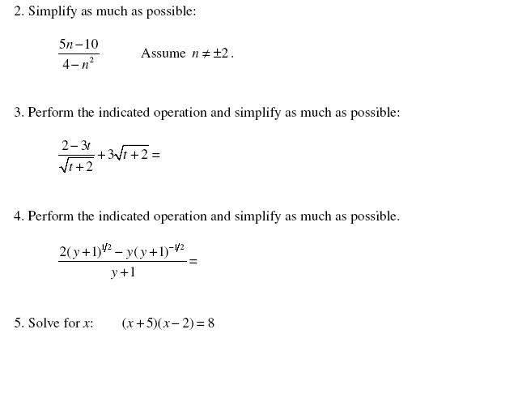
Algebra: Structure and Fluency for Calculus
From Calculus I Gateway U of Arizona, Donna Krawczyk

Slide 8
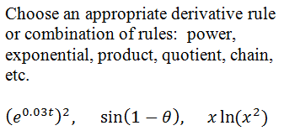
Algebra: Structure and Fluency in Calculus

Slide 9
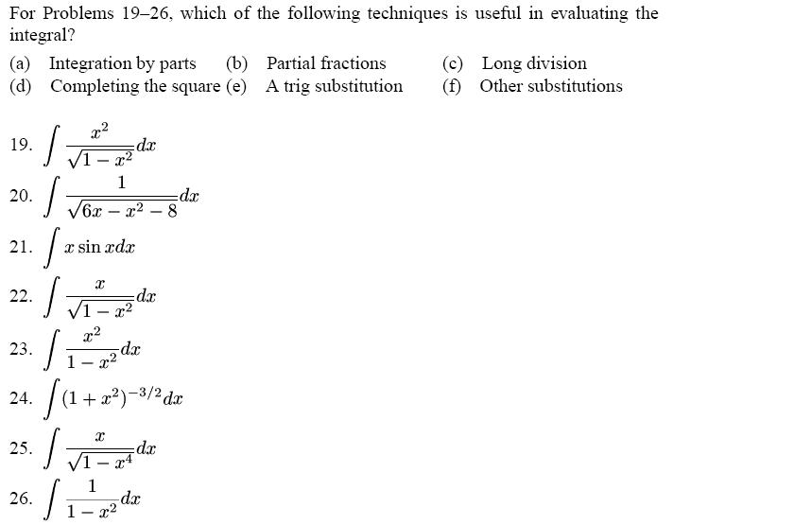
Algebra: Structure and Fluency in Calculus
From Calculus Hughes Hallett et al, ConcepTests

Slide 10
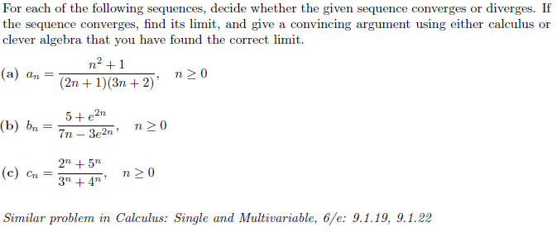
Algebra: Structure and Fluency in Calculus
Cody Patterson Workshop Problems

Slide 11
Historically: Algebra Preparation Focused on Manipulation
Skill in manipulation; focus on drill
However, many students arrive at college not equipped to succeed because of their algebra
Retaking algebra in college leads to students dropping out of mathematics from frustration and boredom⎯better done in HS.

Slide 12
More Recently: Algebra Preparation Based on Functions
Manipulation learned in the context of functions
Do the concepts of functions obscure the concepts of algebra? (Sometimes, yes)
Example: For what values of A does
(x – 5)² = A have a solution?

Slide 13
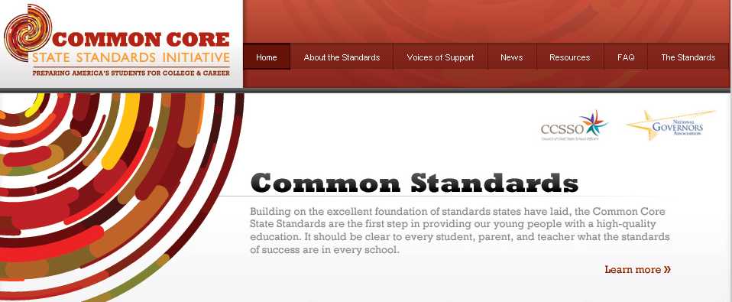
Common Core State Standards
Standards outline what all students should learn K-12.
Some (+) standards intended for students who will take calculus or advanced statistics or discrete mathematics.
Many STEM-intending students will finish the CCSS standards before 12th grade and take calculus in their senior year.
Common Core State Standards: Official site, with all standards listed
http://www.corestandards.org/
Illustrative Mathematics: All standards, plus examples
http://illustrativemathematics.org

Slide 14
Common Core: Algebra http://www.corestandards.org/the-standards/mathematics 2010
Understanding in algebra:
“There is a world of difference between a student who can summon a mnemonic device to expand a product such as (a + b)(x + y) and a student who can explain where the mnemonic comes from.”
“The student who can explain the rule understands the mathematics, and may have a better chance to succeed at a less familiar task such as expanding (a + b + c)(x + y).”

Slide 15
Common Core: Algebra
Structure in Algebra
“[Mathematically proficient students] can see complicated things, such as some algebraic expressions, as single objects or as being composed of several objects. For example, they can see 5 – 3(x – y)² as 5 minus a positive number times a square and use that to realize that its value cannot be more than 5 for any real numbers x and y.”
“[Interpreting] P(1+r)^{n} as the product of P and a factor not depending on P.”
“[Seeing] x⁴ – y⁴ as (x²)² – (y²)², thus recognizing it as a difference of squares that can be factored as (x² + y²)(x² - y²) .”

Slide 16
Common Core: Structure of Expressions
1.2P represents a 20% increase in P
is cubic in n
is linear in P

Slide 17
Common Core: Structure of Expressions
A company’s profit in terms of price, p. What do the following tell you?
Profit when price is zero
Break even prices
Price giving maximum
profit

Slide 18
Common Core: Algebraic Fluency
When is At v = c.
halves when n is quadrupled

Slide 19
Common Core: Algebraic Fluency
Do the following equations have solutions?
Yes
No

Slide 20
Common Core: Algebraic Fluency
Without solving, decide if the equation has a positive, a negative, or a zero solution.

Slide 21

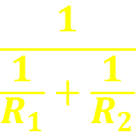
Common Core: Algebraic Fluency
If A − B = 0, what determines the sign of Ax + By?
As increases, what happens to the value of

Slide 22
Examples of Functions and Graphs in Calculus
Families of Functions
Use of Parameters
Relationship between formula for a function and its graph
Modeling
  Setting up a model
  Interpreting the results from a model (use units)

Slide 23
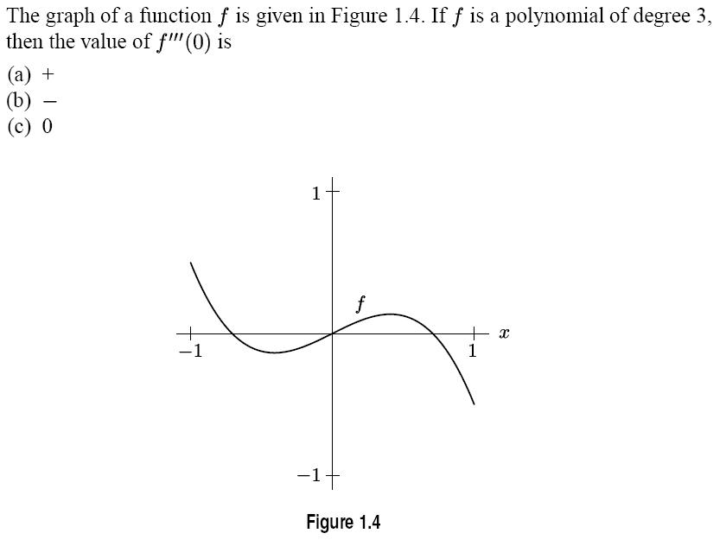
Functions in Calculus: Families
From Calculus Hughes Hallett et al, ConcepTests

Slide 24
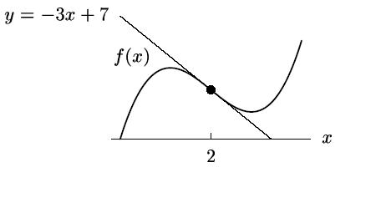
Functions in Calculus: Families
Interpretation of Tangent Lines
The figure shows the tangent line approximation to f(x) near x = a.
Find a, f(a), f ’(a).
Estimate f(2.1) and f(1.98). Are these under- or overestimates? Which would you expect to be most accurate?
(Calculus, Hughes Hallett et al,)

Slide 25
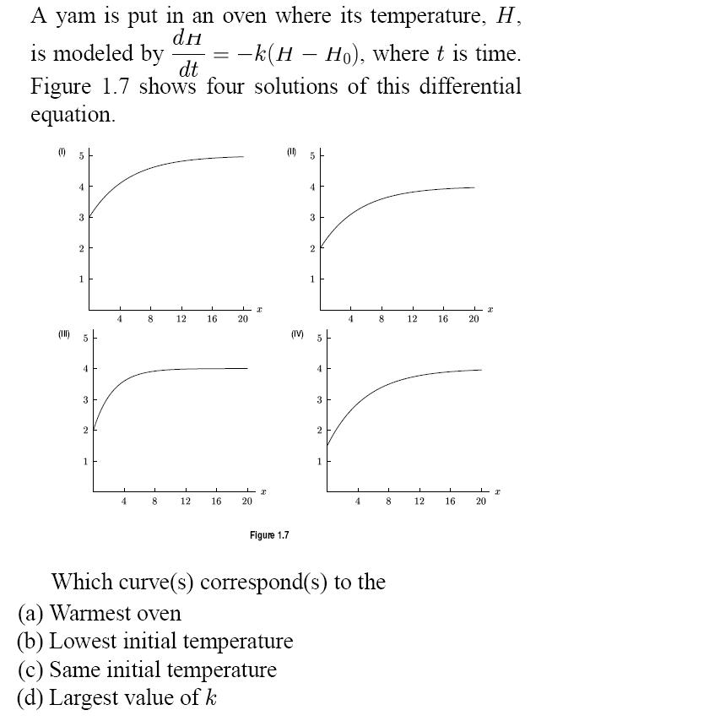
Functions and Modeling
in Calculus
From Calculus Hughes Hallett et al, ConcepTests

Slide 26
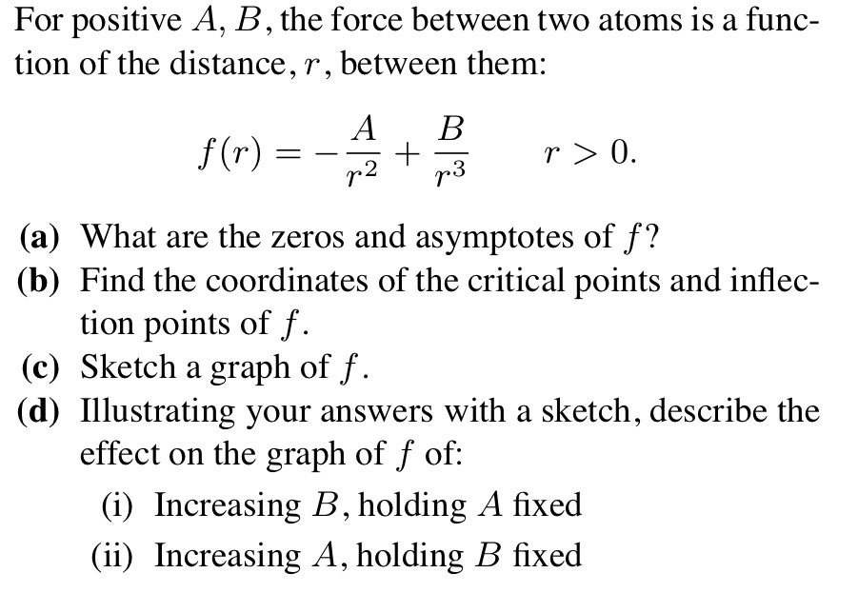
  Functions in Calculus: Parameters
  From Calculus Hughes Hallett et al.

Slide 27
Common Core: Functions
Building functions
  For example, as a model
Interpreting Functions
  Qualitative behavior
  From graph

Slide 28
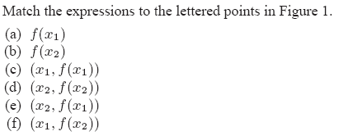
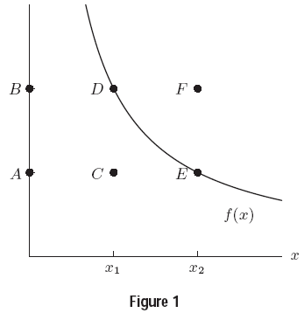
Basic: Functions and Graphs
From Functions Modeling Change by Connally, Hughes Hallett, et al

Slide 29
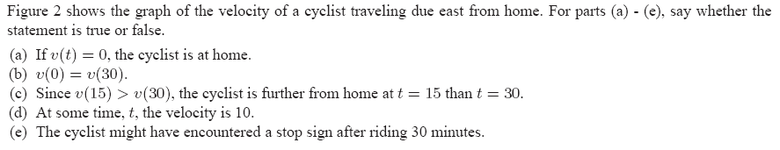
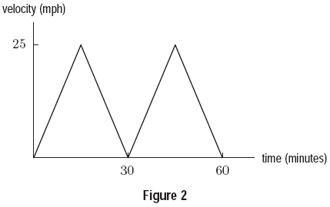
Functions and Graphs: Interpretation
From Functions Modeling Change by Connally, Hughes Hallett, et al

Slide 30
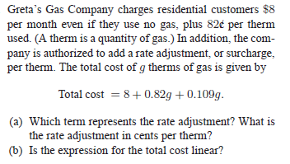
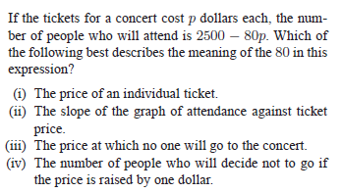
Common Core:
Functions and Interpretation
From Algebra by McCallum, Connally, Hughes Hallett, et al

Slide 31
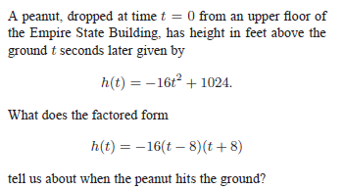
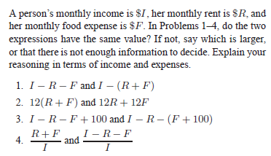
Common Core: Functions and Interpretation
From Algebra by McCallum, Connally, Hughes Hallett, et al

Slide 32
Student Beliefs About Mathematics:
Harvard Undergraduates
(about 1990)
Answer choices for each question:
Disagree 1 2 3 4 5 Agree
A well-written problem makes it clear what method to use to solve it
  Calculus students: 4.1, precalculus: 4.6
If you can’t do a homework problem, you should be able to find a worked example in the text that will show you how
    Calculus students: 4.1, precalculus: 4.7
Review problems should have the section of the text they come from listed after them in parentheses
    Calculus students: 4.2, precalculus: 4.8

Slide 33
What Should Calculus Preparation Look Like?
Algebra: Develop insight into the structure of expressions; achieve fluency through reasoning
Functions and Graphs: Qualitative behavior, parameters, families
Modeling: Create a model; interpret results in context
Stamina and Strategy: Make repeated attempts, try multiple approaches. Choose the best tools, graphs, algebra, technology

Slide 34
Going to college without being “symbolically literate” is like going to college illiterate: Calculus, the Sciences, and Engineering are blocked off
Students have the opportunity to be very well prepared for Calculus under the Common Core State Standards

Slide 36
Structure from the Viewpoint of Other Disciplines: Economics and Biology

Slide 37
Economists and Algebraic Structure:
Consumer Price Index (CPI) Data is as follows:

Slide 38
Economists’ View of the CPI Data
Converting to linear form provides a way to answer the question:
“How fast has the CPI grown over last century?”

Slide 39
Now Equation Has Linear Form:
Variables are y = ln(CPI) and x = Year

Slide 40
Biologists’ Use of Algebraic Structure
Michaelis-Menten Equation
V₀ is initial velocity of chemical reaction
[S]₀ is initial concentration of substrate
V_{max}, K_{M} are constants
How Do We Know If a Reaction Follows Michaelis-Menten?

Slide 41
Does a Chemical Reaction Follow Michaelis-Menten?
Put in linear form, with variables 1/V₀ and 1/[S]₀

Slide 42
Now Equation Has Linear Form:
Variables are y = 1/V₀ and x = 1/[S]₀

